Slide 1
Reporting your statistical approach and results in a paper
November 29, 2021
Notes:
Good checklist for moving forward.

Slide 2
Exercise: Assess methods & results section of published papers
Read the abstract and last paragraph of the introduction to get a sense of what they did.
Evaluate, using the checklist:
statistical approach in the methods
statistical results
tables with statistical results (may need to go online for supplemental info)
Figures representing results
Notes:
Find a paper that seems relatively close

Slide 3
Methods
Statistical analysis can be in a single section at end of methods, or interspersed throughout methods if there are several different components of the study with different statistical approaches.
Typically, use past tense. Can be active or passive voice.
The order of questions addressed should match the introduction and results.

Slide 4
Methods
Must include:
Which hypothesis you are testing with a given analysis
3 watersheds testing buffer strip effect in agroforestry system
Name & citation of statistical software and any packages used for analysis or graphing.
SAS 9.1, proc GLM
How data were summarized (mean, percent, etc.) and what you are using for measures of variability (e.g. SD, SE, 95% CI), if relevant
Total PPT & DOC, significance set at 95%
Statistical tests, with associated data transformations, if relevant
Log-log
Assessment of model fit
Not listed
Method of inference (e.g. p-values from full model or reduced model with significance level, post-hoc tests, likelihood ratio test, model selection via AIC)
Explanation of any aberrations from standard process (e.g. how you dealt with outliers, missing data, correlated predictors, etc.)

Slide 5
Methods: linear models (including generalized & mixed effects)
What type of model did you use? (e.g. lm, glm, glmer)
Describe response. Justify use of transformations, if applicable.
Describe error distribution used.
Identify predictors, and any scaling/transformations (if applicable)
Justify any random effects that were used.
Include equation for your model (not always done, but generally appreciated)
Describe methods you used to assess model adequacy
Describe how you approached model selection and/or hypothesis testing
If you used model selection:
Describe alternative models you fit to data (if appropriate)
Outline protocol for model selection (e.g. AIC, likelihood ratio test)
If you used post-hoc analyses (e.g. emmeans, glht):
Describe what you used.
Mention how you dealt with overdispersion, if relevant.
If using new statistical method, may need to explain in more depth.
Follow journal’s instructions to authors
Notes:
p. 458 Zuur

Slide 6
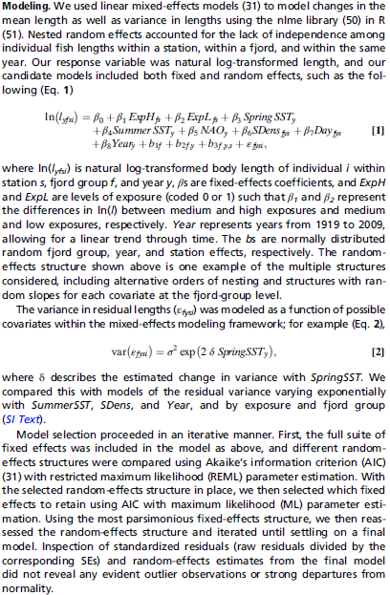
Notes:
Relatively thorough analysis description from Rogers et al 2011 (not H. Rogers), in methods section.

Slide 7
Methods: Multivariate statistical approach
Follow all general guidelines
And…
Clearly state methods used for visualization and statistical analysis.
Mention dissimilarity/distance index used, and reason it was chosen

Slide 8
Results section
Choose only the necessary graphs, tables, and data for telling your story.
Craft a descriptive sentence or set of sentences that explain what you found, biologically. Keep the statistics to parentheses or tables.
“By day 8, cowbirds reared with host young were, on average, 14% heavier than cowbirds reared alone (unpaired t₁₆ = −2.23, P = 0.041, Fig. 2A).”(Kilner et al. 2004)
Use subsections if there are multiple parts
If you want to discuss data in the discussion, you must present it in the results.
Notes:
Each major/main analysis should have a figure associated with it in the paper.

Slide 9
Results- in text
Mention how you got to final model.
E.g. ‘using model selection, we …’
Report assessment of model adequacy (e.g. R² from predicted/observed; proportion of deviance explained)

Slide 10
Results - in text
Describe relationships between variables in best fitting model (e.g. as x increased, y decreased); Should only do this with significant variables.
Present estimated mean (coefficient from model) and standard error from optimal model

Slide 11
Results – in text, table, or figures
For LM report all F and p values if even non-significant.
Text: (Test Name, F = all values , p = all values)
If use Likelihood Ratio Test to test whether something is significant, report p-value (chi symbol with df, LRT, and p-value)
P values are more informative than symbols such as * and **

Slide 12
Results- in table
For single model:
Present estimated parameters, standard errors, degrees of freedom (if available)
May be difficult to get degrees of freedom from mixed effects models
For model selection:
Table showing model rankings with log likelihoods, AIC’s, maybe delta AIC’s.
Whether or not to present intermediate models is a matter of preference, space

Slide 13
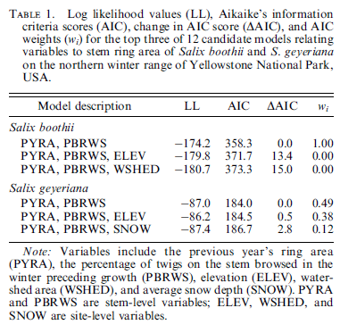
Model Selection Beyer et al 2007 Ecol. App.

